Slide 1
Project 2
Darryl Bunn
Antonio Gomez
Robert Riggs
Jonathan Torres

Slide 2

What Categories see the most Sales?

Slide 3
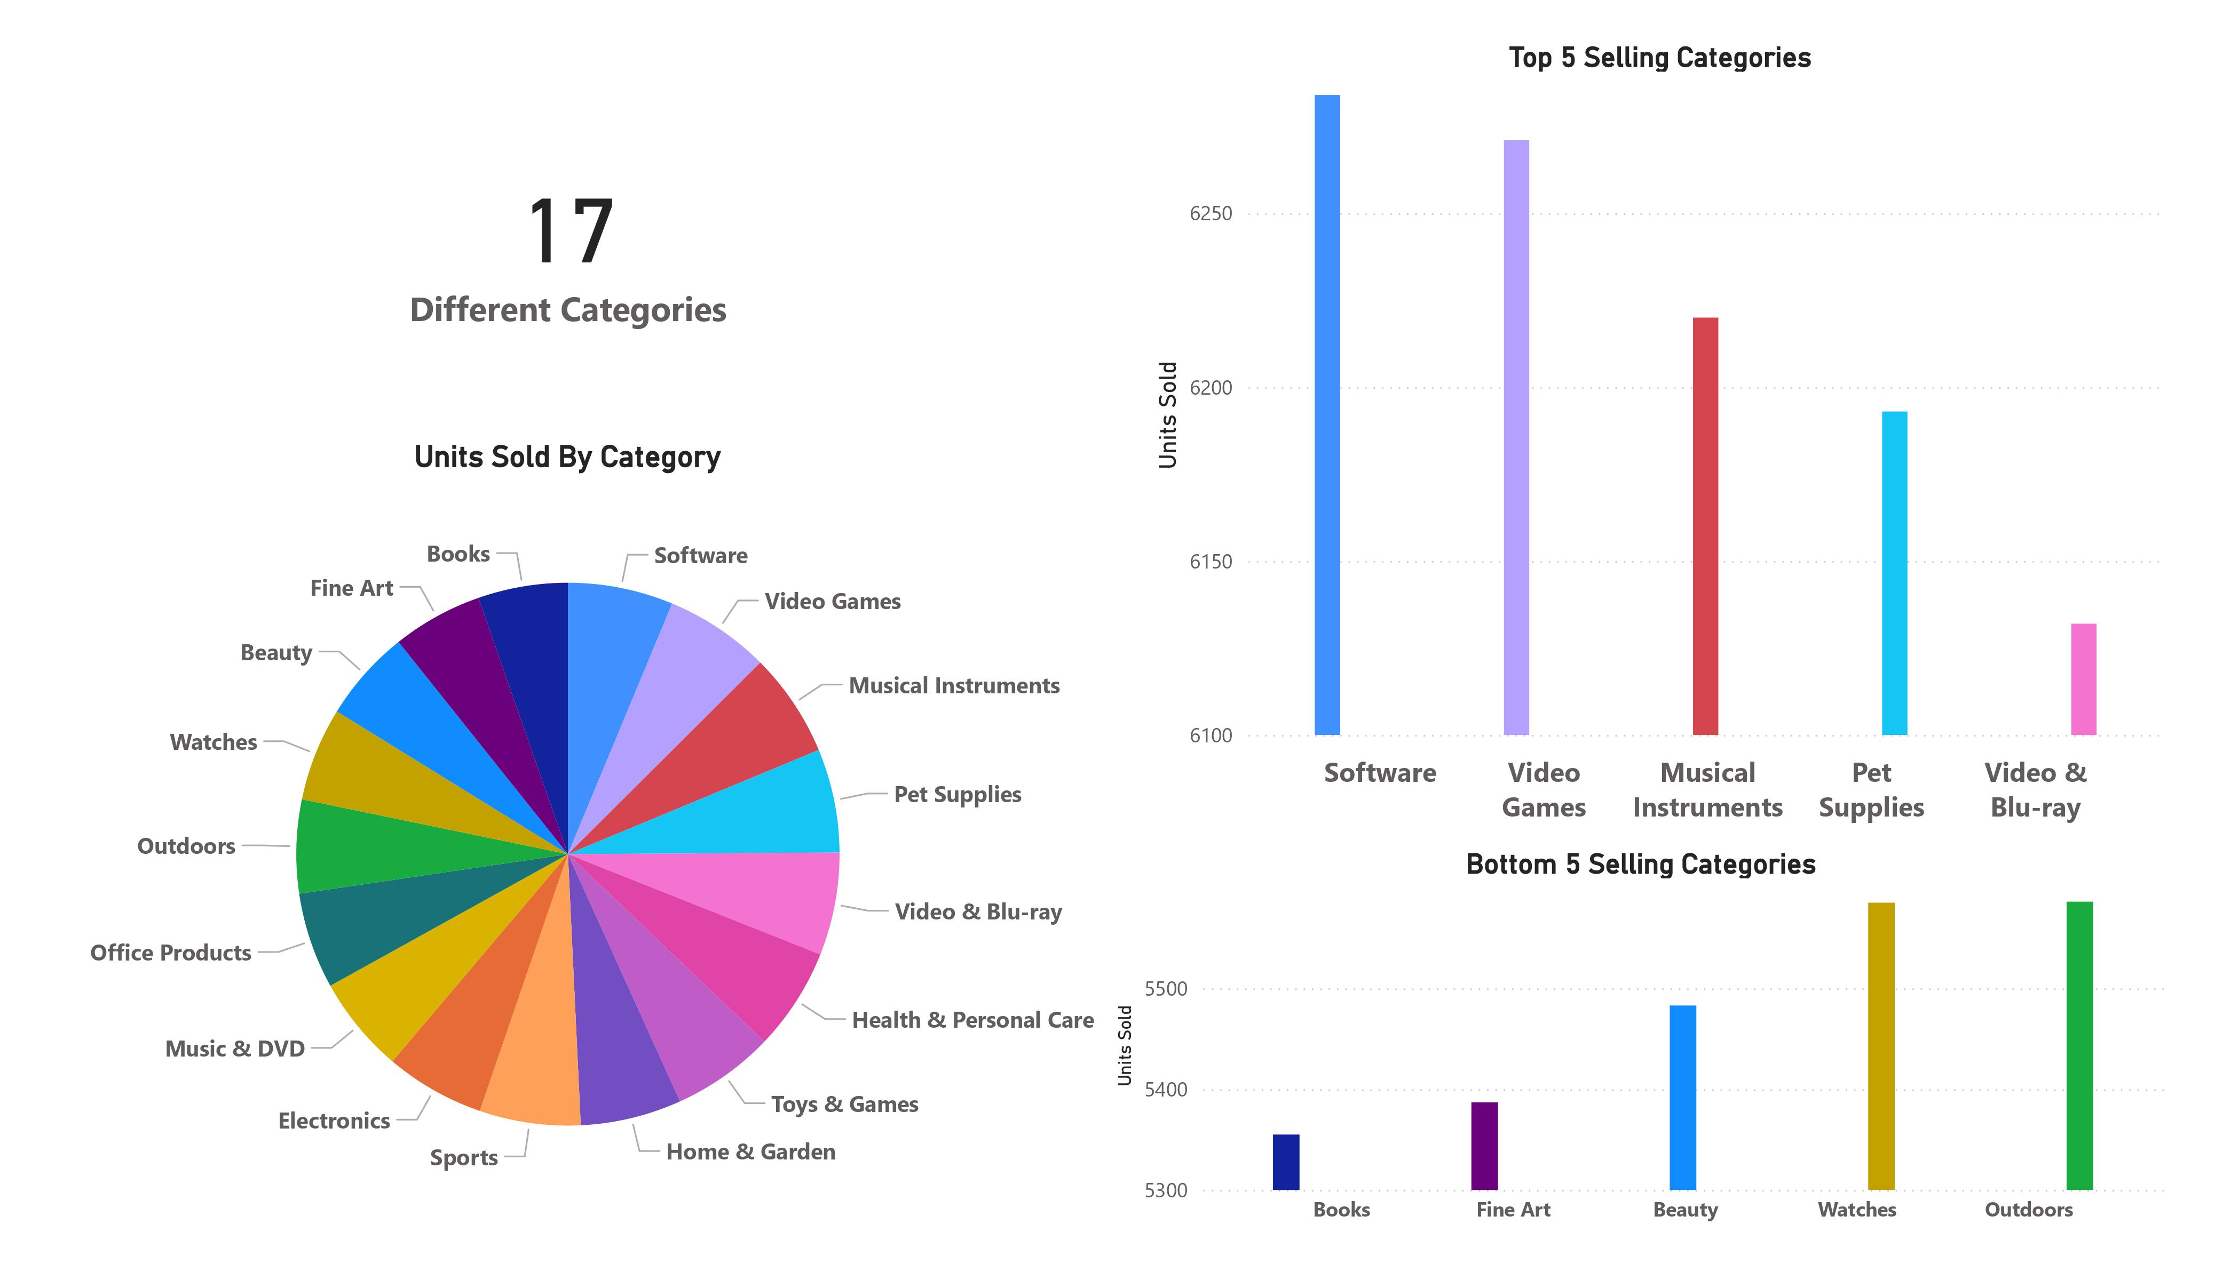

Slide 4
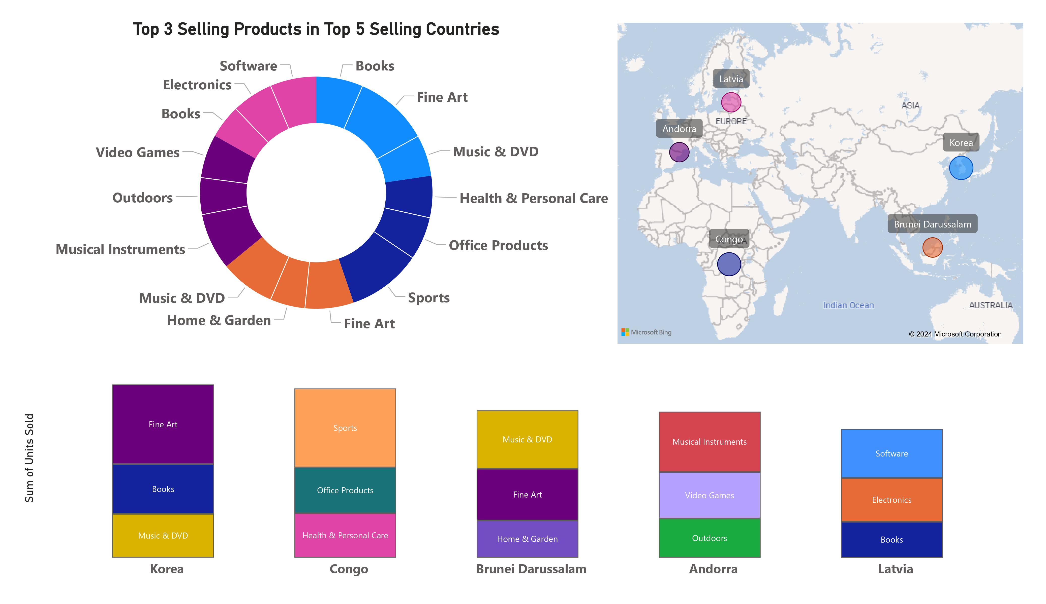

Slide 5
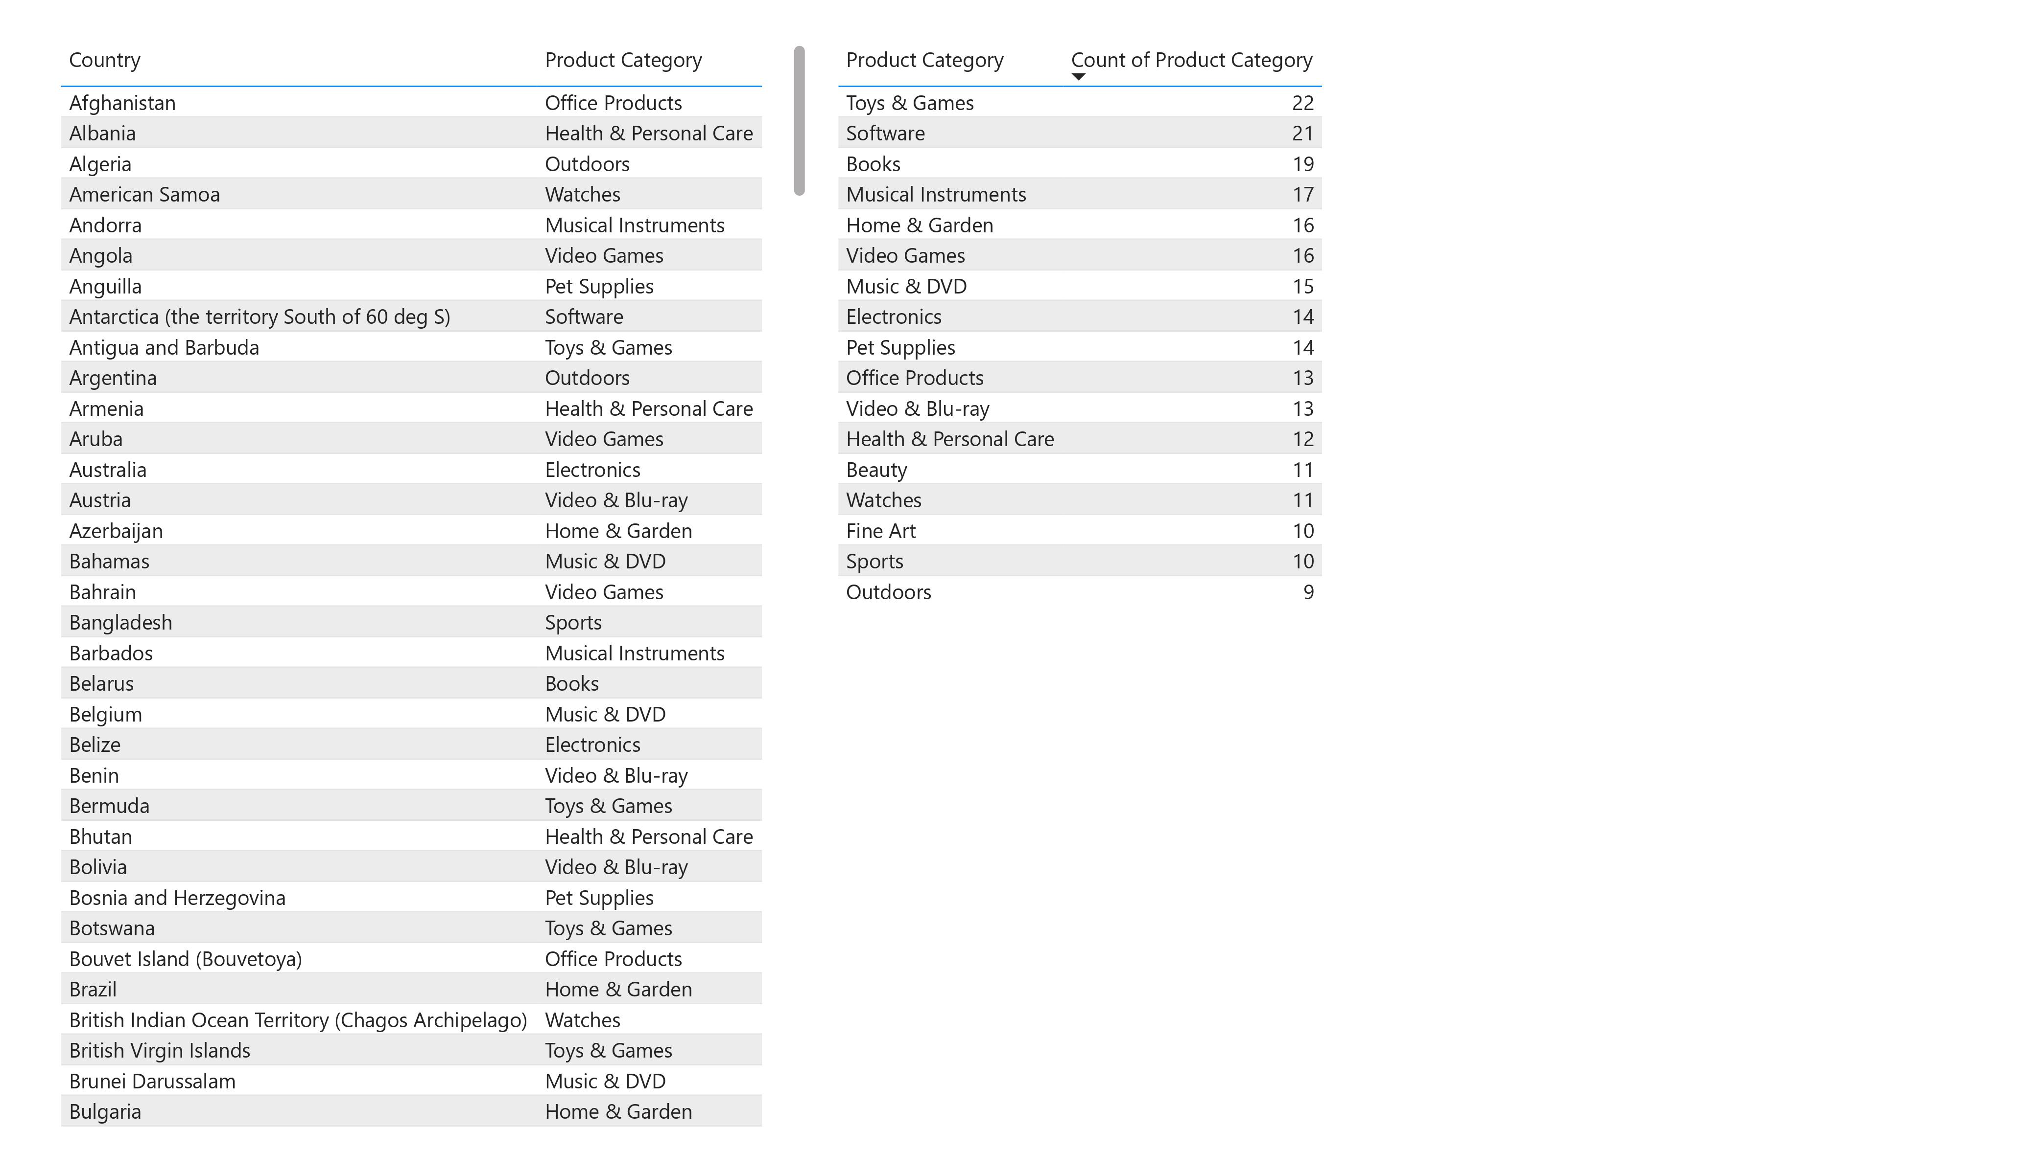

Slide 6
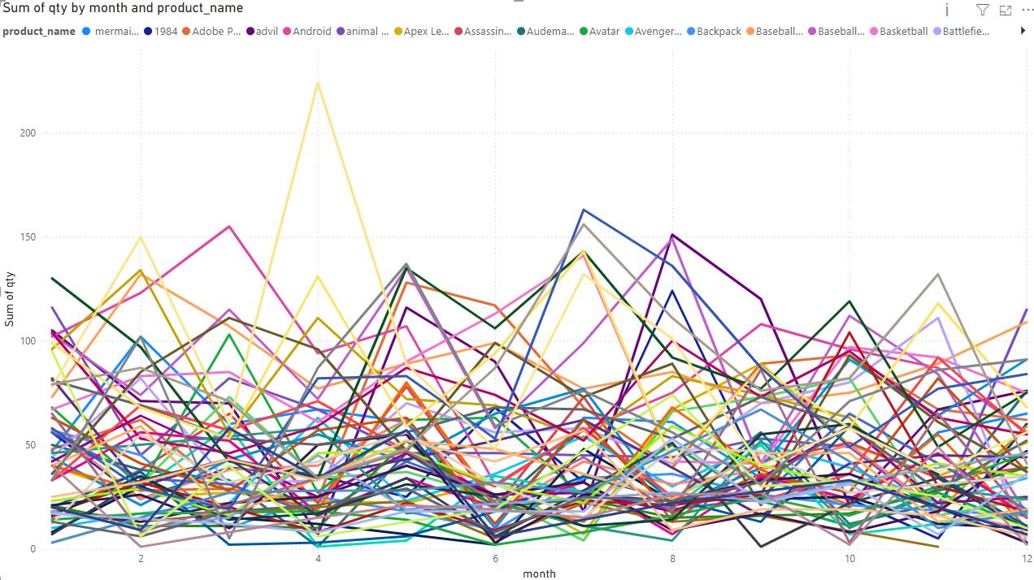
How does the popularity of products change throughout the year?

Slide 7
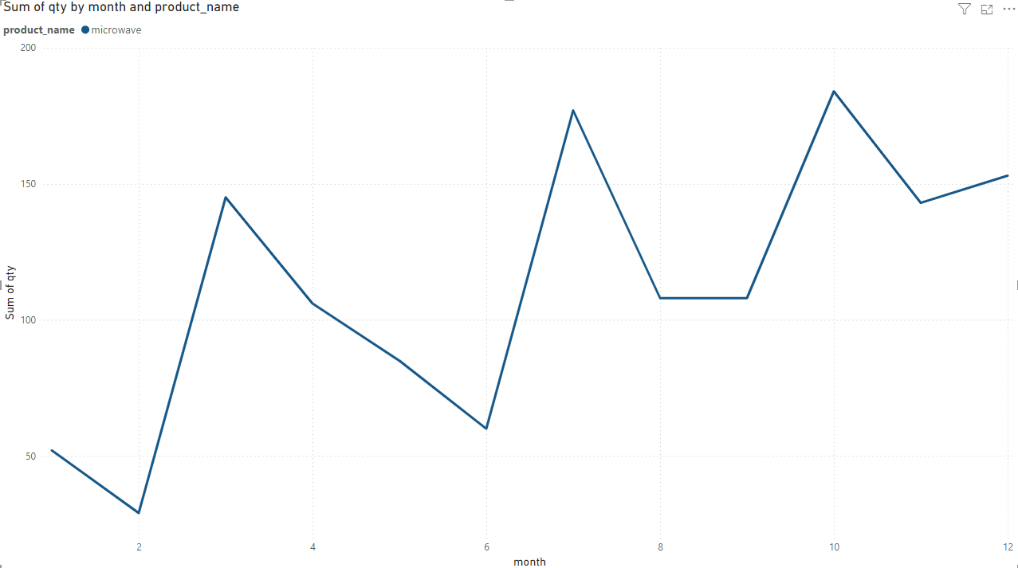
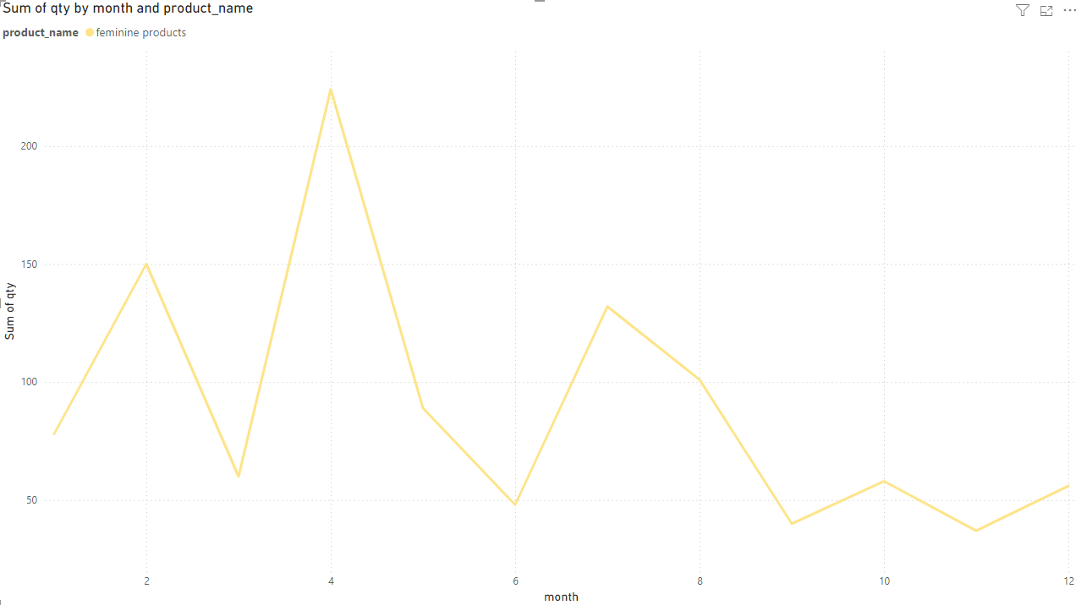
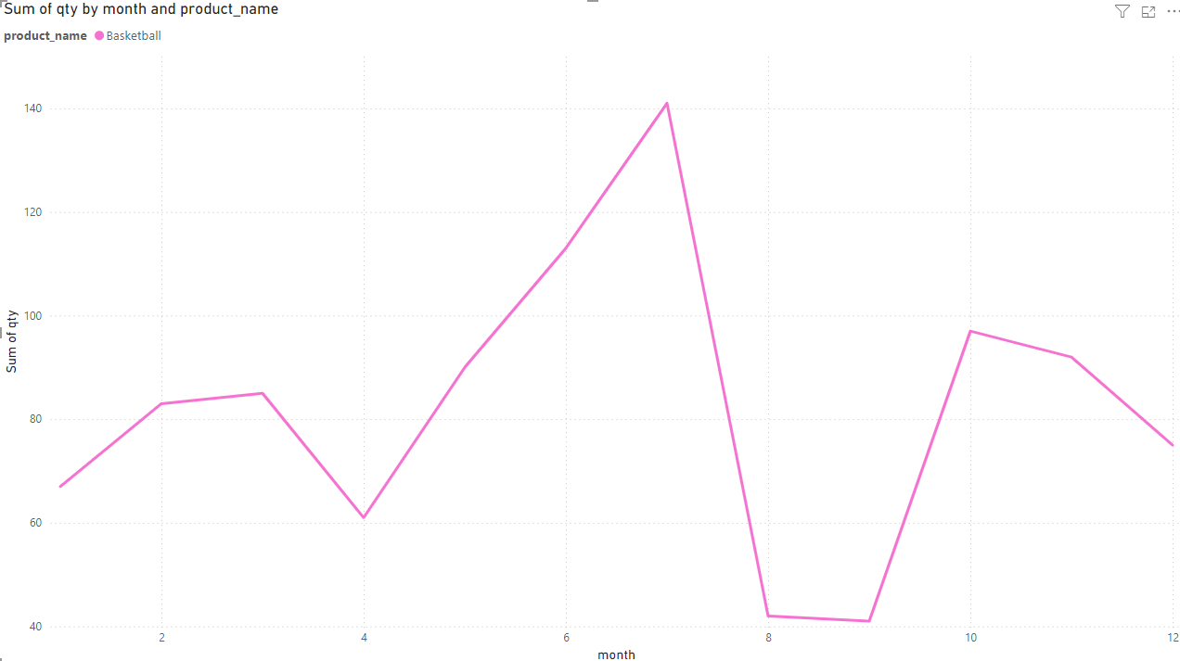
Examples of filtering by certain products

Slide 8
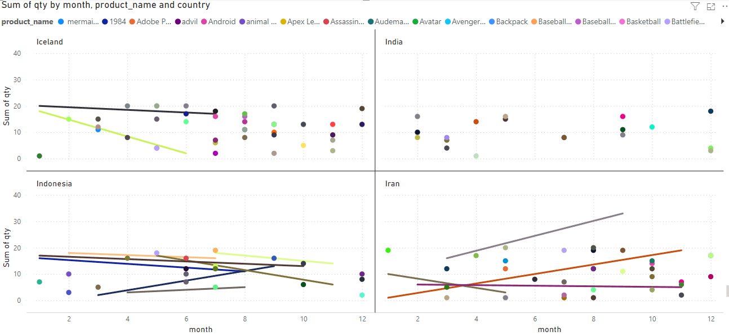
How does the popularity of products change throughout the year, per country?

Slide 9
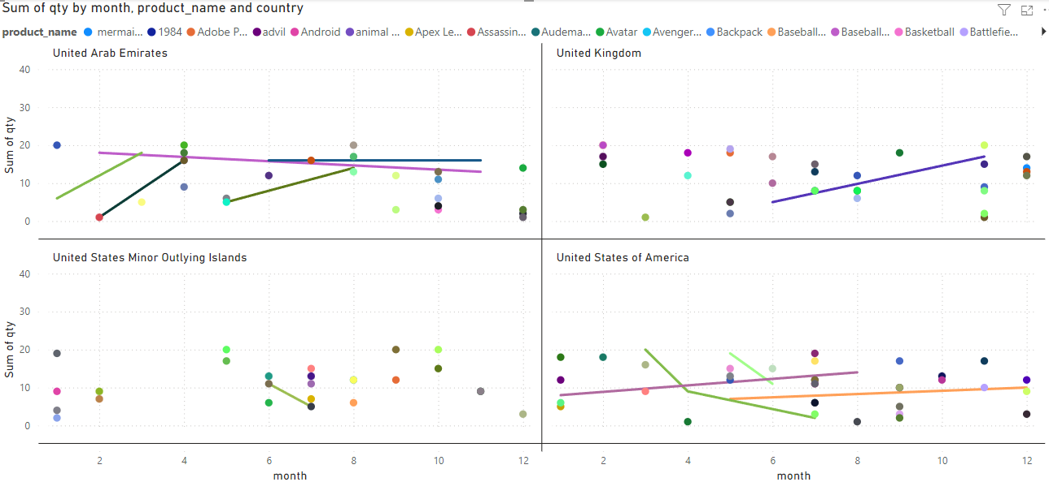

Slide 10
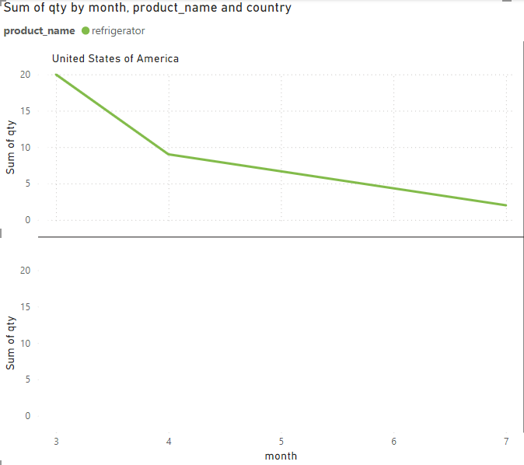
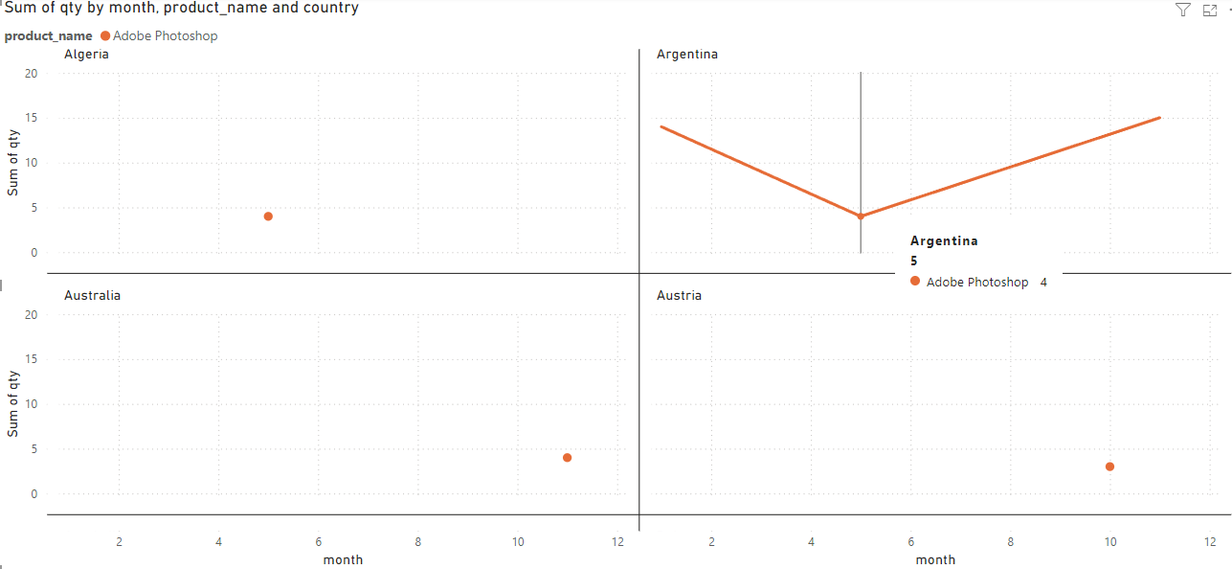
Example of filtering by a specific country and product
Example of filtering by a specific product

Slide 11

Which locations see the highest traffic of sales..

Slide 12
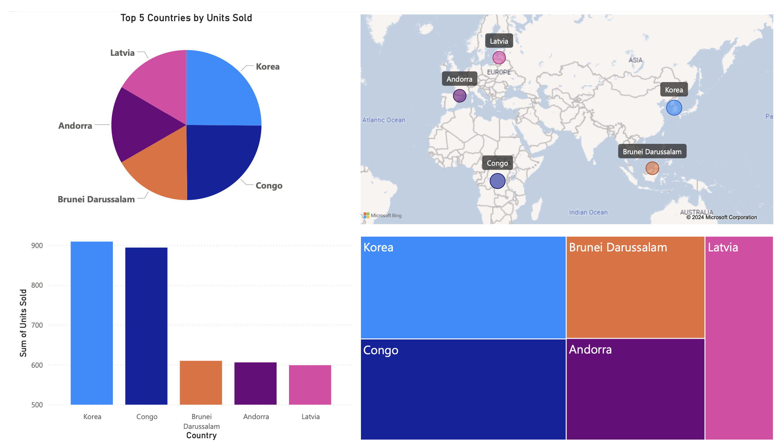

Slide 13
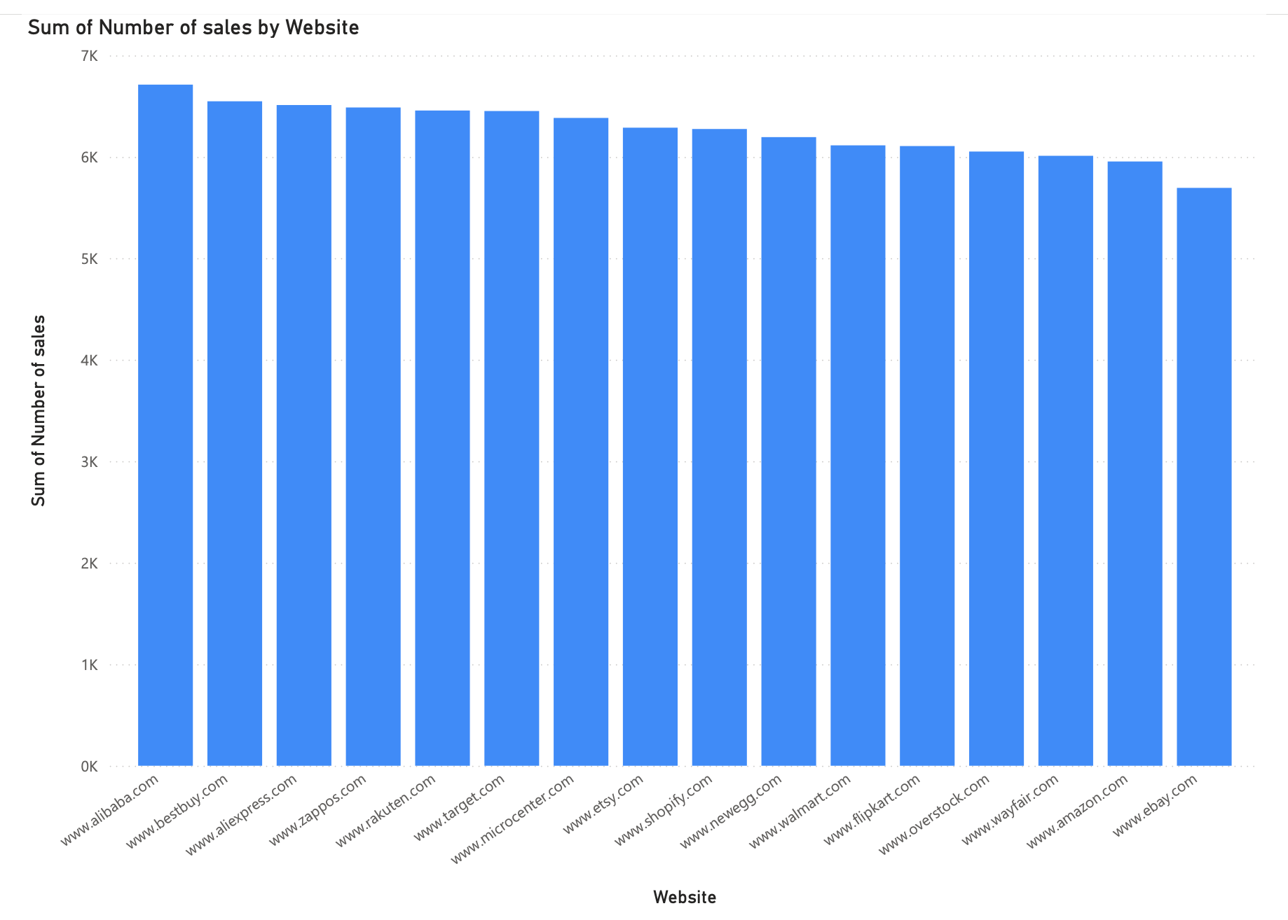
By website

Slide 14
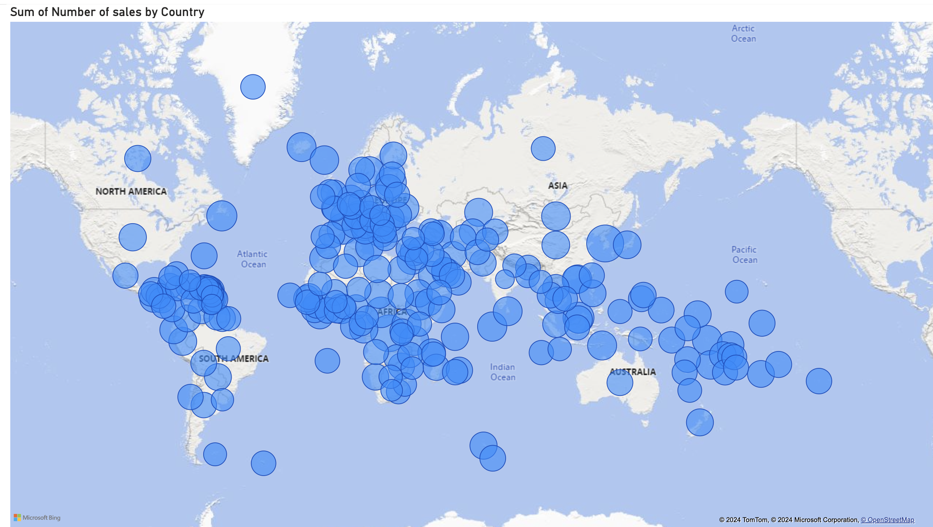

Slide 15
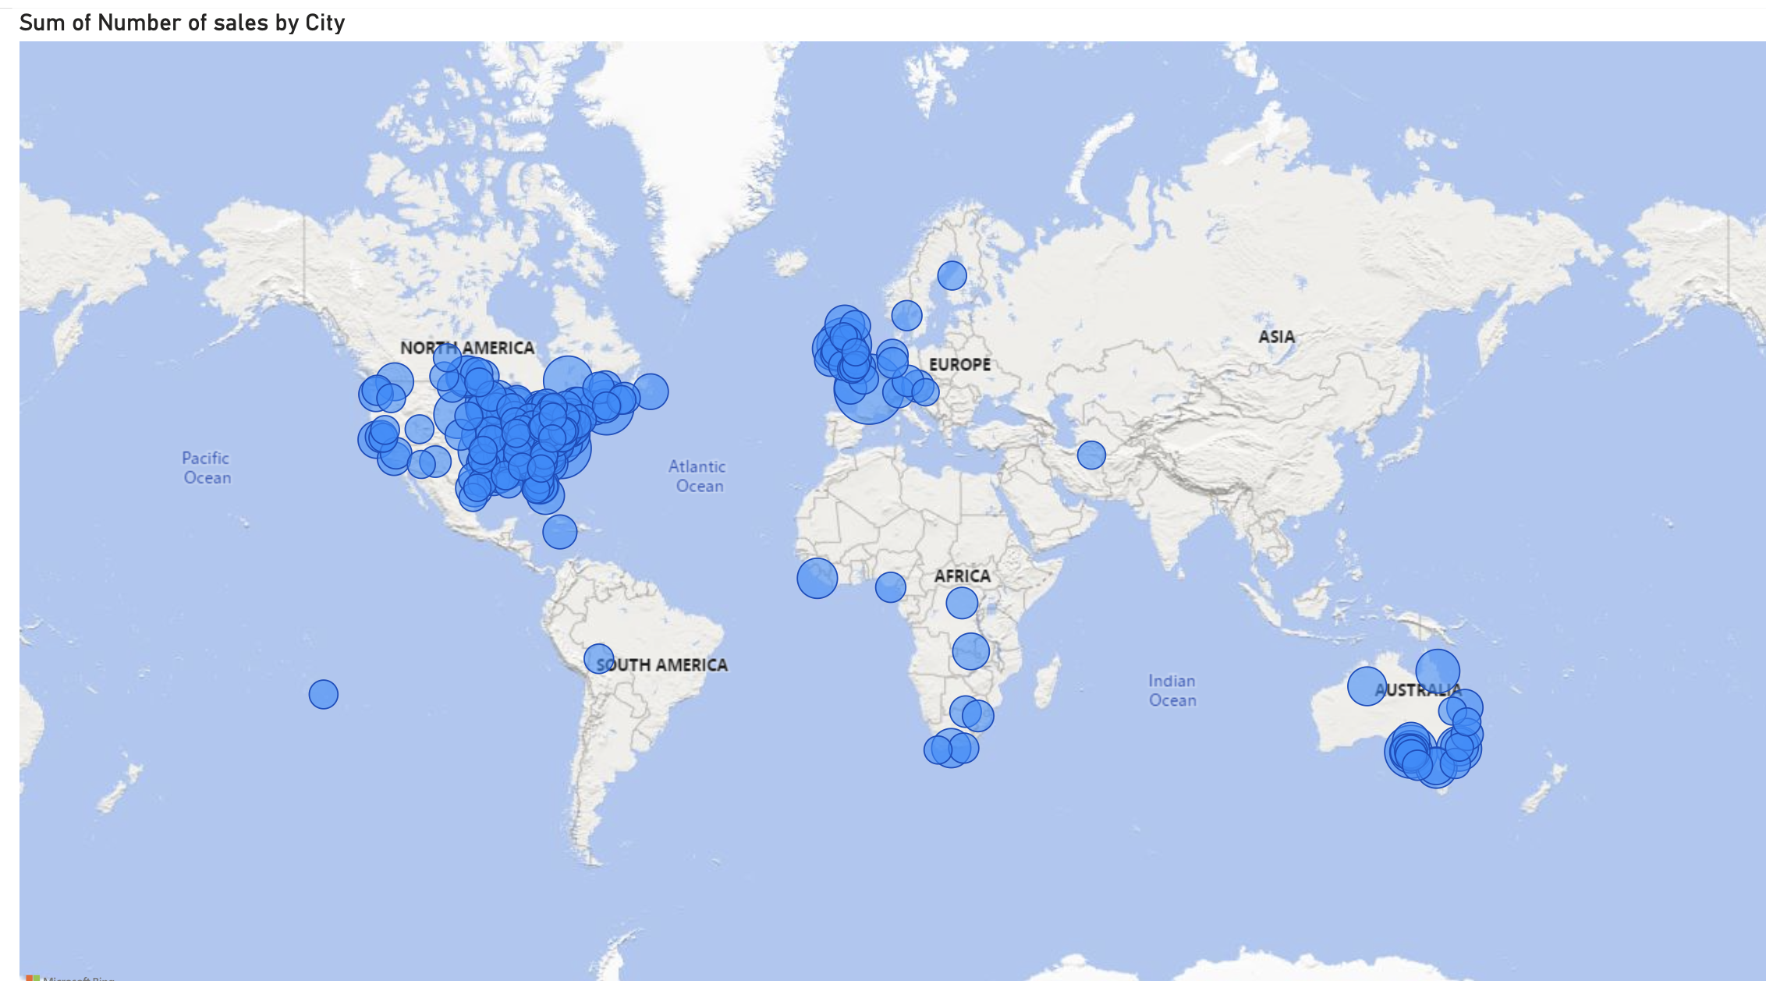

Slide 16

Observations
Since most of our sales occur in the middle/East countries, targeting those countries with marketing strategies can yield the greatest return based off geographical location.
Although it appears more cities in the west place orders, the total number of sales are much less in total when compared to the East/Southern countries. Using this insight more marketing tailored to high traffic cities in the west can be promoted to result in higher ticket item sales or multiple orders being made. Thus, increasing profit from already high occurring traffic.

Slide 17
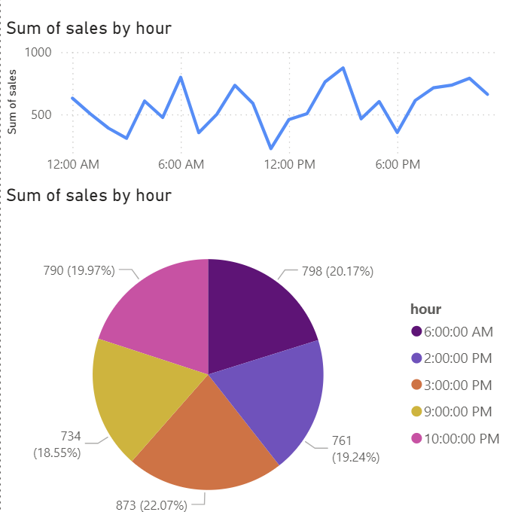

Slide 18
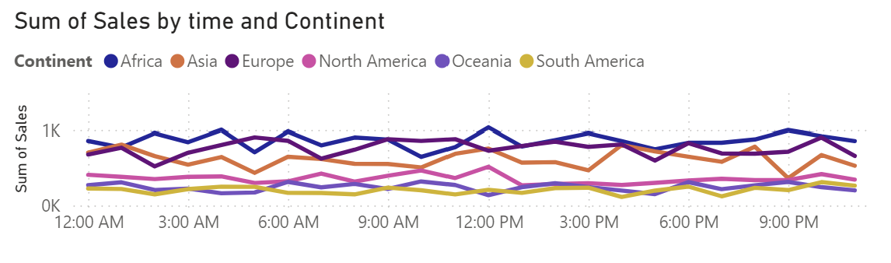

Slide 19
